Slide 1
Logel User Guide
TOOL

Slide 2
Table of Contents
Quick view
Quick start to capture log
Quick start to play log file
Capture Setting
Parser Setting
Views
Search
Bookmark
Window management
Filter
Tools
Toolbar
Status bar
CMD Parameters

Slide 3
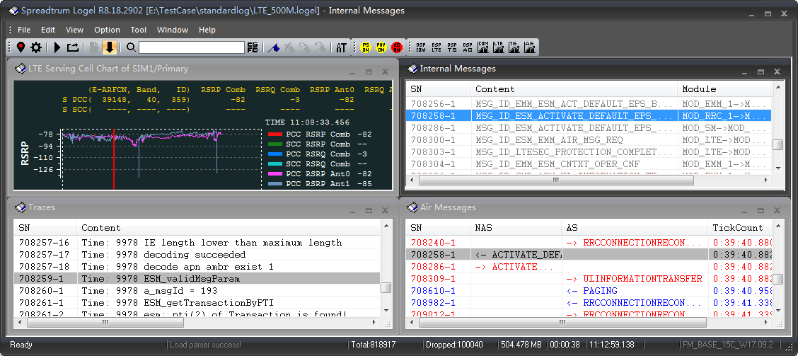
Quick View
Tool Version
Modem Version

Slide 4
Quick start to capture log
Click button on the toolbar to capture log，it will change to if successfully
Logel Tool connects to device by UART type
Logel Tool can auto identify the port by default
Notice:
If you did not use SPRD drivers, maybe the port name is not identified by Logel Tool,
so you need to select right ports in Capture Setting window before clicking button

Slide 5
Quick start to play log file
Play .logel/.lst/.log file
Click button on the toolbar to open log file, it will change to if successfully

Slide 6
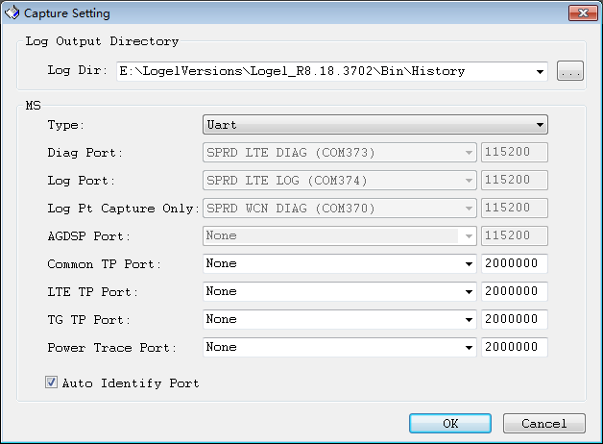
Capture Setting
Click Button on the toolbar to show capture setting
Capture Settings
Log Dir: set the log files output folder
Type UART：
Diag port：used to communicate with device
Log port： only used to receive log data
Log Pt Capture Only: used to capture and save to file
usually used to capture WCN log raw data to a file.
AGDSP Port: only used to receive AG DSP log data
Common TP Port: use to receive DSP raw data by UART
LTE TP Port: use to receive DSP raw data by UART
TG TP Port: use to receive DSP raw data by UART
Power Trace Port: use to receive power trace data by UART
Auto Identify Port: switch to manual or auto identify ports
Type Channel-Server(Simba)：
Set Address(IP) and Port to connect to Channel-Server tool or Simba tool, using Socket protocol encapsulated DIAG packet without 7E header and tail, no escape byte.
Type Socket:
Set Address(IP) and Port to connect to simulator, using Socket protocol encapsulated DIAG packet
Type FILE:
Open one or more .log files to replay

Slide 7
Capture Setting – Port Notice
Type | Name | Protocol | Notice
DIAG | SPRD LTE DIAG | DIAG | Communicate with modem and output modem dump data when modem assert
 | SPRD DIAG(SENSOR HUB) | DIAG | Communicate with modem and output modem log if no SPRD LTE DIAG device
 | SPRD U2S DIAG | DIAG | Communicate with device in calibration mode
 | SPRD WCN DIAG(LOG) | DIAG | Communicate with WCN modem
LOG | SPRD LTE LOG | SMP | Output PS and DSP log of Modem
 | SPRD WCN DIAG(LOG) | SMP | Output WIFI Trace and BT DSP log of WCN Modem
 | SPRD U2S DIAG | SMP | Output system dump files using SMP protocol in System Dump mode,
 | SPRD LOG(AGDSP) | SMP | Output AGDSP data such as TP, Audio, IQ, mem.
AT | SPRD LTE AT(WIQ) | AT | Communicate with Modem by AT command
 | SPRD AT | AT | Communicate with Modem by AT command if no SPRD LTE AT device shows
 | SPRD WCN AT | AT | Communicate with WCN modem by AT command
UART | USB SERIAL PORT | RAW | Output raw data such as DSP, Power Trace data
 | SPRD LTE AT(WIQ) | RAW | Output WIQ raw data in WIQ mode, only for old projects who have no SPRD IQ device
 | SPRD IQ | RAW | Output WIQ raw data, and only show in WIQ mode
Download | SPRD U2S DIAG | Boot Mode | Burn SW files to flash using boot-mode protocol in download mode

Slide 8
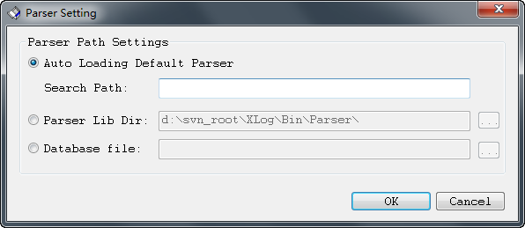
Parser Setting
Click menu Option->Parser Settings
Auto Loading Default Parser:
Tool will find parser and load the matched parser,
search order:
Bin\Parser
Search Path
Parser Server
Device
If no matched parser used Bin\Parser with the Logel
Search Path: the local parsers folder storing parsers.
Parser Lib Dir:
Specify a parser folder to decode the log
Database file:
Set the parser got from YLOG, such as modem_db.gz
Notice:
Parser is very import to decode the log.
Make sure the parser is matched with the modem version.
You can find the parser in the project release package, under the Logel tool bin\Parser folder.

Slide 9
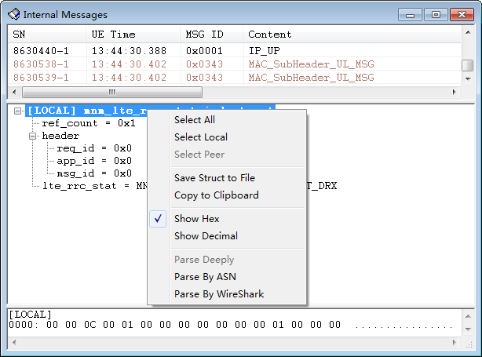
[View] Internal Messages(1)
Three sub windows in this frame
Top is message list
Middle is message content: LOCAL & PEER
Bottom is message raw data : LOCAL & PEER
Message content menu
Select All: Select all items this tree
Select Local: Select all LOCAL items this tree
Select Peer: Select all PEER items this tree
Save Struct to File: Save all content to file
Show Hex: Show value by hex
Show Decimal: Show value by decimal
Copy to Clipboard: Copy selected items to clipboard ( Ctrl + C )
Parse Deeply: Decode special container to extra text tree window
Parse By ASN: Decode by ASN.1 to current tree
Parse By Wireshark: Decode by Wireshark to extra text tree window

Slide 10
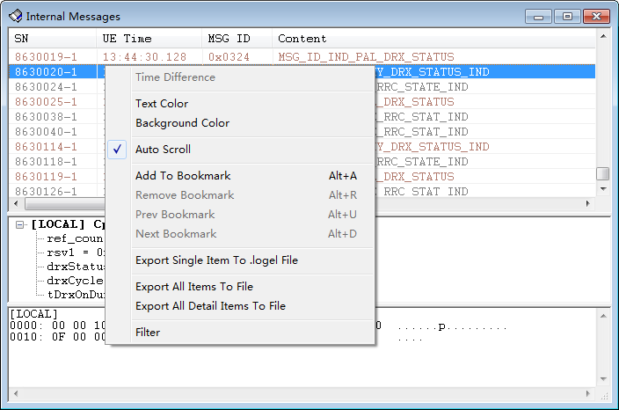
[View] Internal Messages(2)
Popup menu in message list window
Time Difference
Add to Bookmark (Alt+A)
Pre Bookmark (Alt+U)
Next Bookmark (Alt+D)
Filter
Parse and show message content
Double click item to show content in bellow two windows
Sync to other view
Double click item
Other view sync to this view
Double click item in other view to sync to this view

Slide 11
[View] Internal Messages(3)
Parse Deeply
Decode the content with parser lib
Logel tool can decode bellows:
3G: MIB/MSG_ID_DM_UTRAN_CLASSMARK_IND
utran_classmark
3G: attcah_request
ms_nw_cap, ms_ra_acc_cap
4G: attcah_request
ue_nw_cap, esm_message_container_contents,ms_nw_cap
4G: attach_accept
esm_message_container_contents
4G: UECAPABILITYINFORMATION
4G: ROUTING_AREA_UPDATE_REQUEST
ms_ra_acc_cap,ms_nw_cap

Slide 12
[View] Internal Messages(4)
Parse By ASN
Decode the content with ASN.1 protocol
Logel try to use ASN.1 protocol to decode the content
If decode success, the new decoded content will show in current tree view
If decode fail or cannot be decoded, current view no change.
e.g.
RRCCONNECTIONSETUPCOMPLETE
ueCapabilityContainer

Slide 13
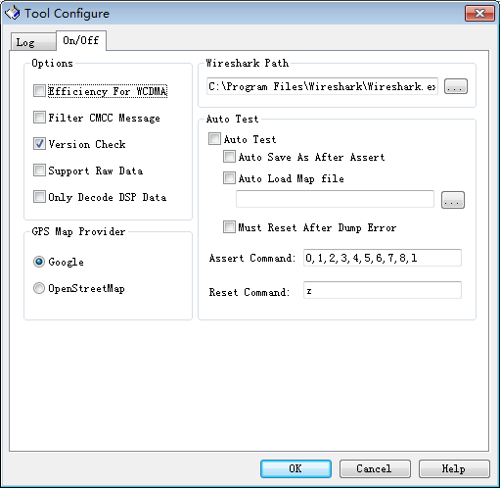
[View] Internal Messages(5)
Parse By Wireshark
Decode the content with Wireshark
Logel tool can decode the message content by message name listed in
\3rd\WireShark\src_3gpp.txt
Before use this function, you need install Wireshark first, then set the install path in Option->Tool Configure->Configure.
e.g.
ULINFORMATIONTRANSFER
dedicatedInfoNAS
DLINFORMATIONTRANSFER
dedicatedInfoNAS
UECAPABILITYINFORMATION
container

Slide 14
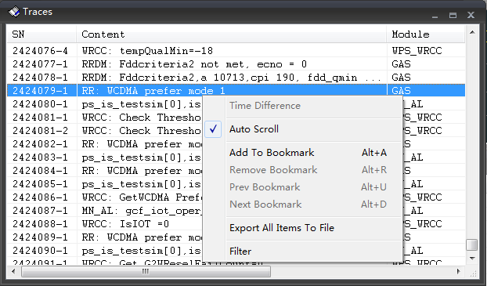
[View] Traces
Popup Menu
Add to Bookmark (Alt+A)
Pre Bookmark(Alt+U)
Next Bookmark(Alt+D)
Export All Item To File
Filter
Sync to other views
Double click the item to sync

Slide 15
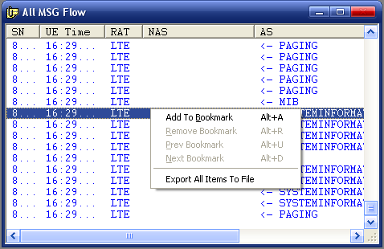
[View] Air Messages
Air Message Flow list
Popup Menu
Add to Bookmark (Alt+A)
Remove Bookmark (Alt+R)
Pre Bookmark(Alt+U)
Next Bookmark(Alt+D)
Export All Item To File
Sync to other views
Double click the item to sync

Slide 16
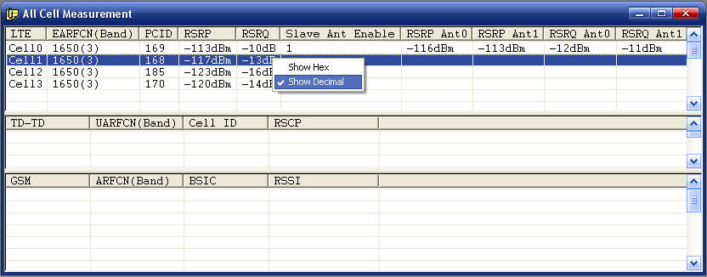
[View] Cell Measurements
Support 2 SIM
Three windows in this frame
Top is LTE cell measurement
Middle is TD/WCDMA cell measurement
Bottom is GSM cell measurement
Popup menu
Show value by Hex or Decimal
Open the view by the menu
View->Common-> All Cell Measurement
This view can be closed

Slide 17
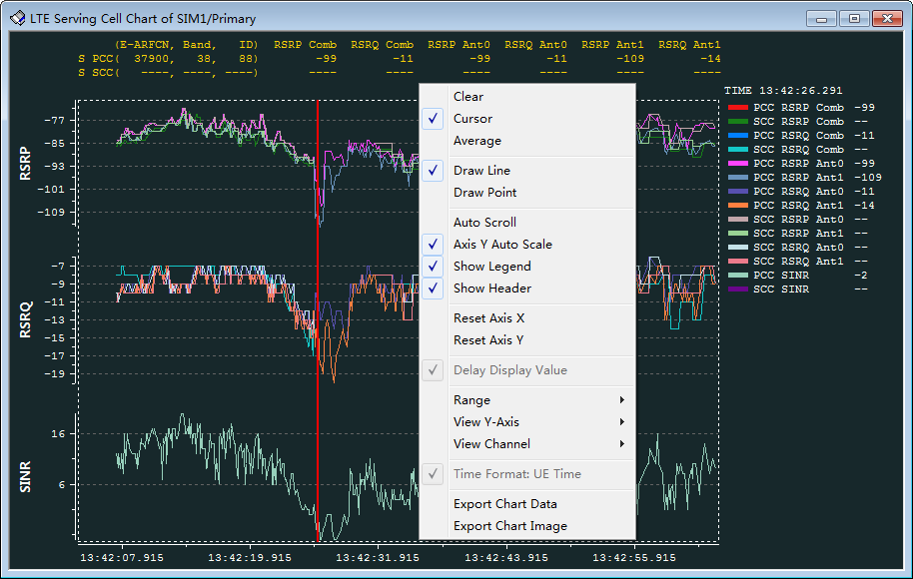
[View] Chart – Basic Function
Open any XXX Chart in the menu View
Clear: Pop up menu -> Clear, Clear chart
Cursor: Pop up menu -> Cursor, plus data value in the legend
Calculate Average: Pop up menu -> Average
Auto Scroll: Pop up menu -> Auto Scroll
Zoom
Scroll mouse wheel directly
Scroll
Hold mouse left button and move left and right in the chart field.
Draw Line : Pop up menu -> Draw Line
Draw Point : Pop up menu -> Draw Point
Show or Hide Header: Pop up menu -> Show Header
Show or Hide Legend: Pop up menu -> Show Legend
Reset Axis X to zero position: Pop up menu -> Reset Axis X
Reset Axis Y to original position: Pop up menu -> Reset Axis Y
Delay Display Value: Pop up menu -> Delay Display Value
This is for data refresh too quick to see clearly, chart will delay to display value
Set Time Display Range: Pop up menu -> Range
View or Hide Axis Y: Pop up menu -> View Y-Axis
View or Hide Lines: Pop up menu -> View Channel
Sync with other view: Double click the chart field to sync with other views
Clear: Pop up menu -> Clear, Clear chart
Cursor: Pop up menu -> Cursor, plus data
Save chart data to user specified csv file:
Pop up menu -> Export Chart Data
Save chart data image:
Pop up menu -> Export Chart Image
Notes:
Requirement ID: RS-ANA-0001

Slide 18
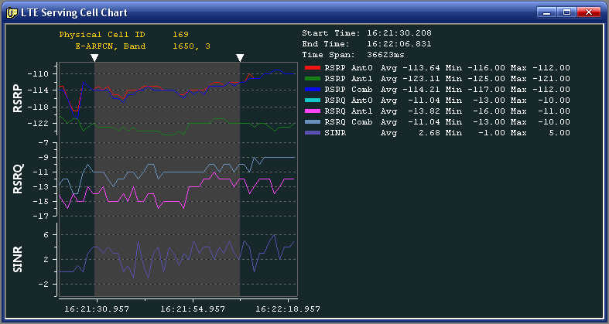
[View] Chart – Average Function
Open the view by the menu
View->xx Chart, Popup menu: Average
Function
Display Average, Min, Max value
Display Time Span
User can move the average field side to select the time range to calculate average value.
Notes:
Requirement ID: RS-ANA-0001

Slide 19
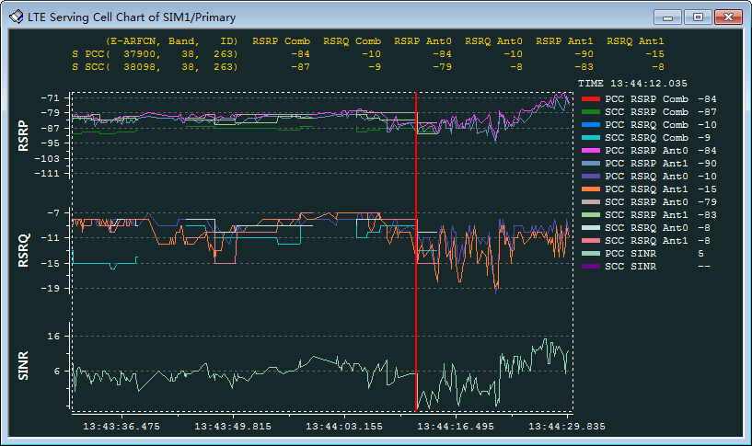
[View] LTE Serving Cell Chart of SIM1/Primary
Open the view by the menu
View->LTE> LTE Serving Cell Chart of SIM1/Primary
Function
Display RSRP/RSRQ Ant0/1, Comb value, SINR
Display Physical Cell ID
Display E-ARFCN, Band
Notes:
Requirement ID: RS-ANA-0001

Slide 20
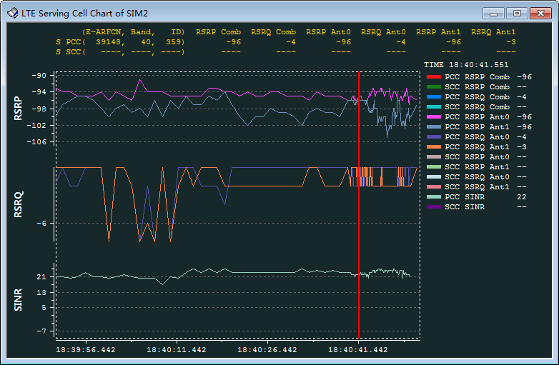
[View] LTE Serving Cell Chart of SIM2
Open the view by the menu
View->LTE> LTE Serving Cell Chart of SIM2
Function
Display RSRP/RSRQ Ant0/1, Comb value, SINR
Display Physical Cell ID
Display E-ARFCN, Band
Notes:
Requirement ID: RS-ANA-0001

Slide 21
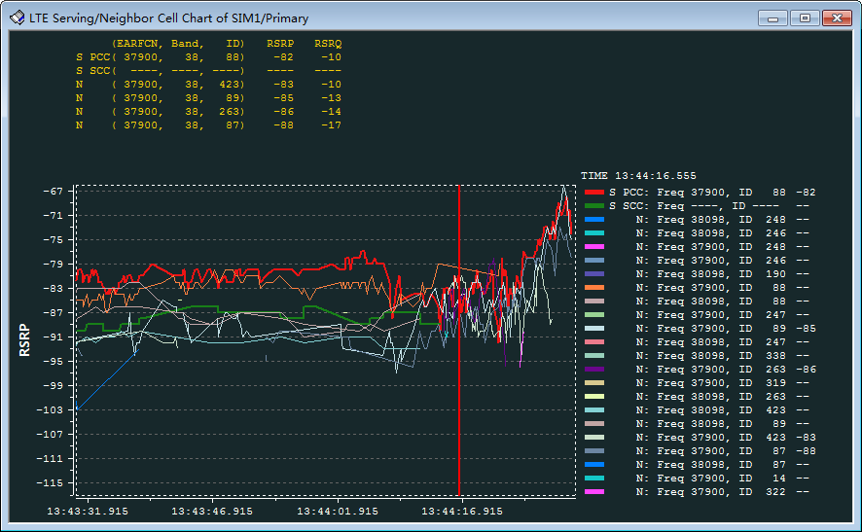
[View] LTE Serving/Neighbor Cell Chart of SIM1/Primary
Open the view by the menu
View->LTE> LTE Serving/Neighbor Cell Chart of SIM1 Primary
Function
Display Serving and Neighbor cell RSRP
Display Physical Cell ID
Display E-ARFCN
Notes:
Requirement ID: RS-ANA-0001

Slide 22
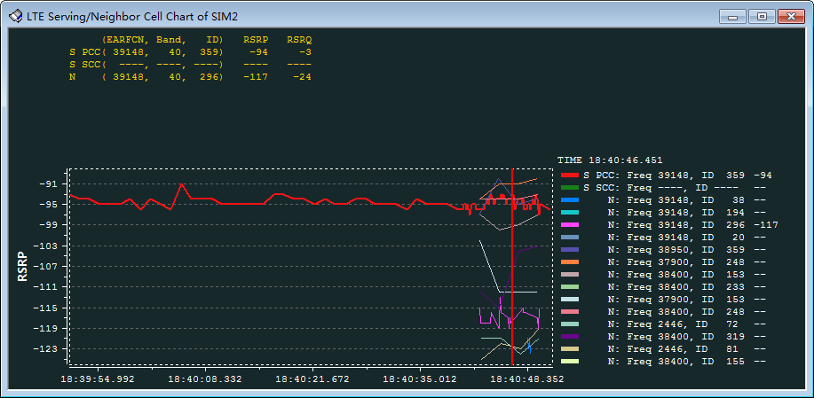
[View] LTE Serving/Neighbor Cell Chart of SIM2
Open the view by the menu
View->LTE> LTE Serving/Neighbor Cell Chart of SIM2
Function
Display Serving and Neighbor cell RSRP
Display Physical Cell ID
Display E-ARFCN
Notes:
Requirement ID: RS-ANA-0001

Slide 23
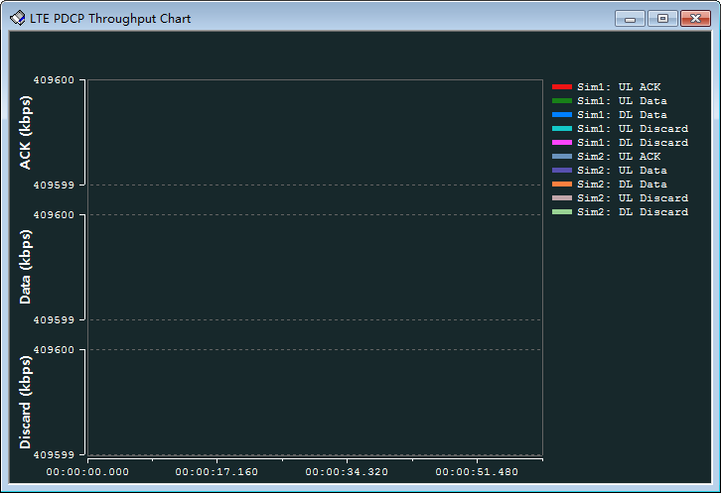
[View] LTE PDCP Throughput Chart
Open the view by the menu
View -> LTE -> LTE PDCP Throughput Chart
Function
Draw PDCP throughput lines

Slide 24
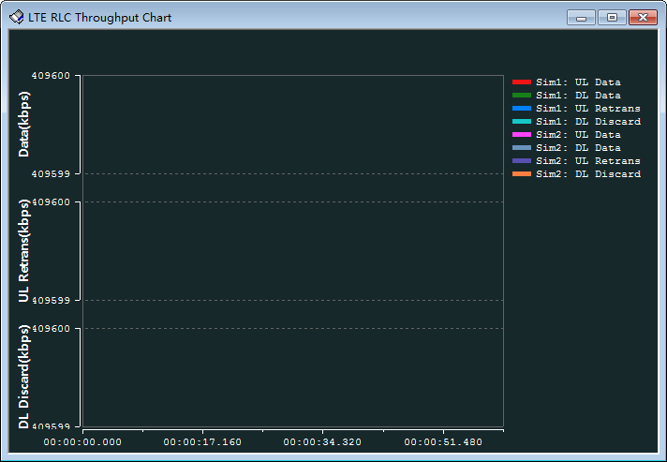
[View] LTE RLC Throughput Chart
Open the view by the menu
View -> LTE -> LTE RLC Throughput Chart
Function
Draw RLC throughput lines

Slide 25
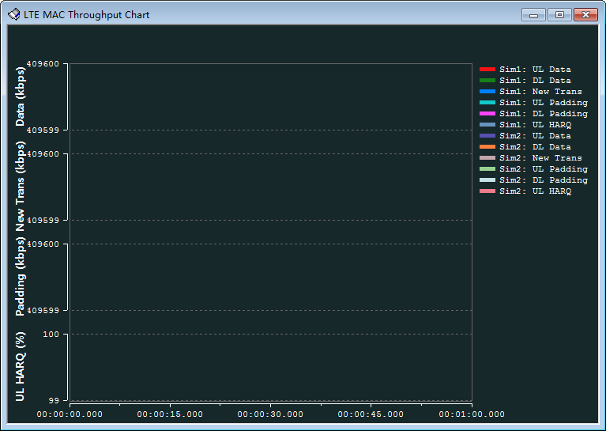
[View] LTE MAC Throughput Chart
Open the view by the menu
View -> LTE -> LTE MAC Throughput Chart
Function
Draw MAC throughput lines

Slide 26
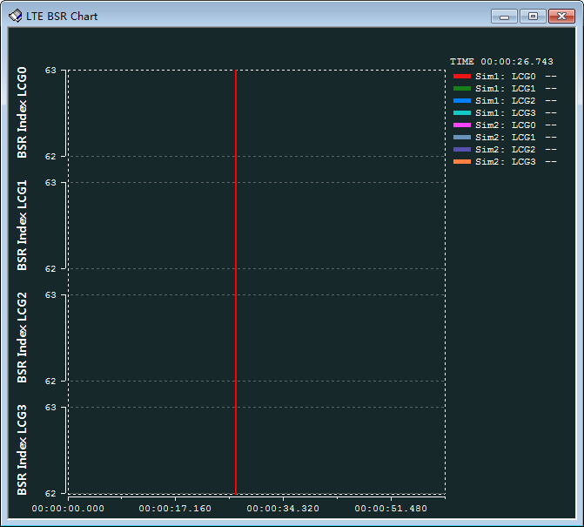
[View] LTE BSR Chart
Open the view by the menu
View -> LTE -> LTE BSR Chart
Function
Draw BSR Index LCG0/1/2/3 lines

Slide 27
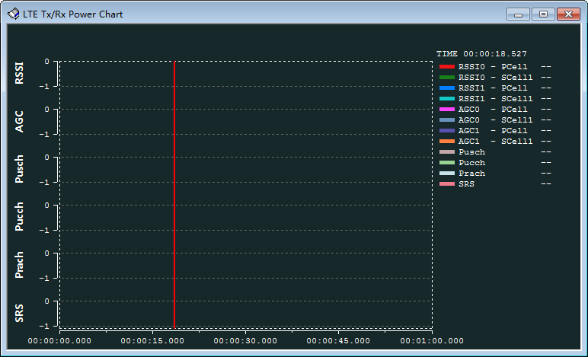
[View] LTE Tx/Rx Power Chart
Open the view by the menu
View -> LTE -> LTE Tx/Rx Power Chart
Function
Draw blow lines
RSSI0
RSSI1
AGC0
AGC1
Pusch
Pucch
Prach
SRS

Slide 28
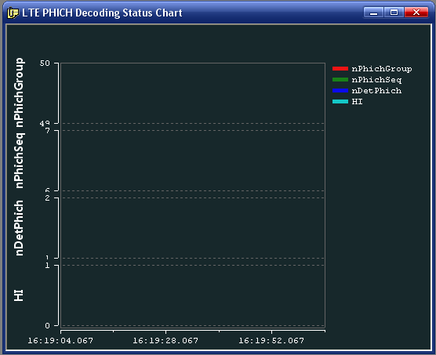
[View] LTE PHICH Decoding Status Chart
Open the view by the menu
View -> LTE -> LTE PHICH Decoding Status Chart
Function
Draw blow lines
nPhichGroup
nPhichSeq
nDetPhich
HI

Slide 29
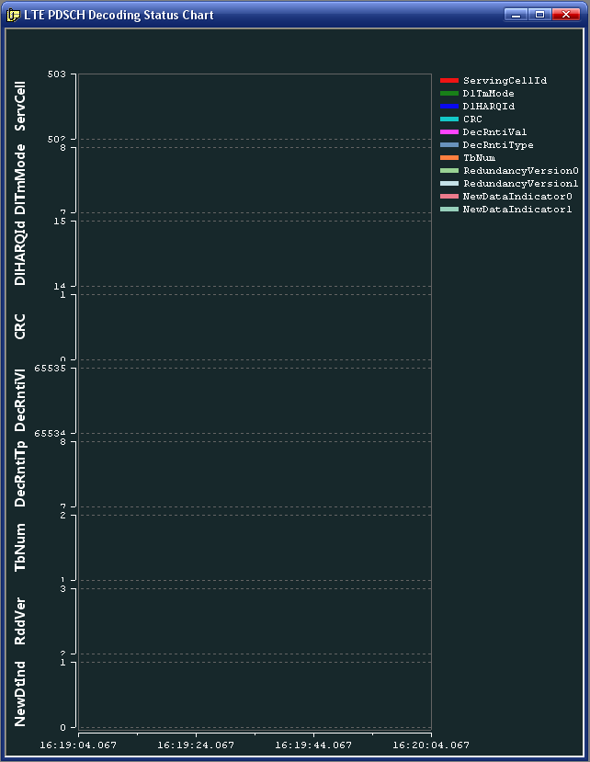
[View] LTE PDSCH Decoding Status Chart
Open the view by the menu
View -> LTE -> LTE PDSCH Decoding Status Chart
Function
Draw blow lines
ServingCellID
DlTmMode
DlHARQId
CRC
DecRntiVal
DecRntiType
TbNum
RedundancyVersion0
RedundancyVersion1
NewDataIndicator0
NewDataIndicator1

Slide 30
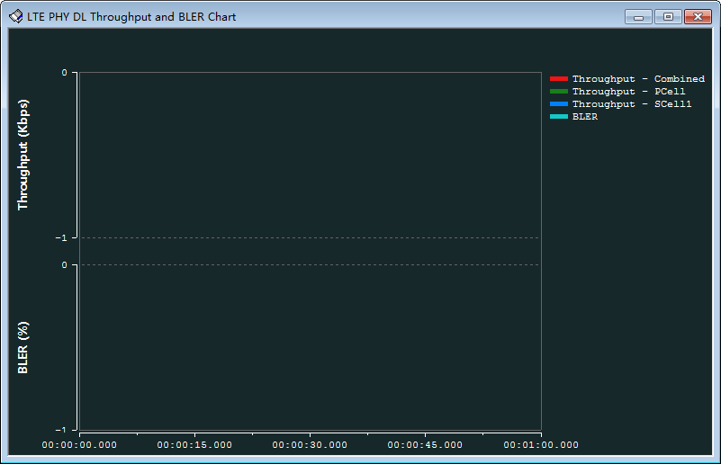
[View] LTE PHY DL Throughput & BLER Chart
Open the view by the menu
View -> LTE -> LTE PHY DL Throughput & BLER Chart
Function
Draw blow lines
DL Throughput Rate
DL BLER

Slide 31
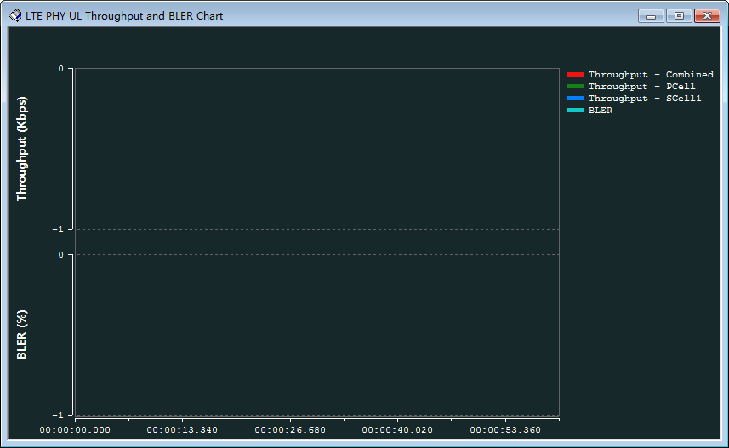
[View] LTE PHY UL Throughput & BLER Chart
Open the view by the menu
View -> LTE -> LTE PHY UL Throughput & BLER Chart
Function
Draw blow lines
UL Throughput Rate
UL BLER

Slide 32
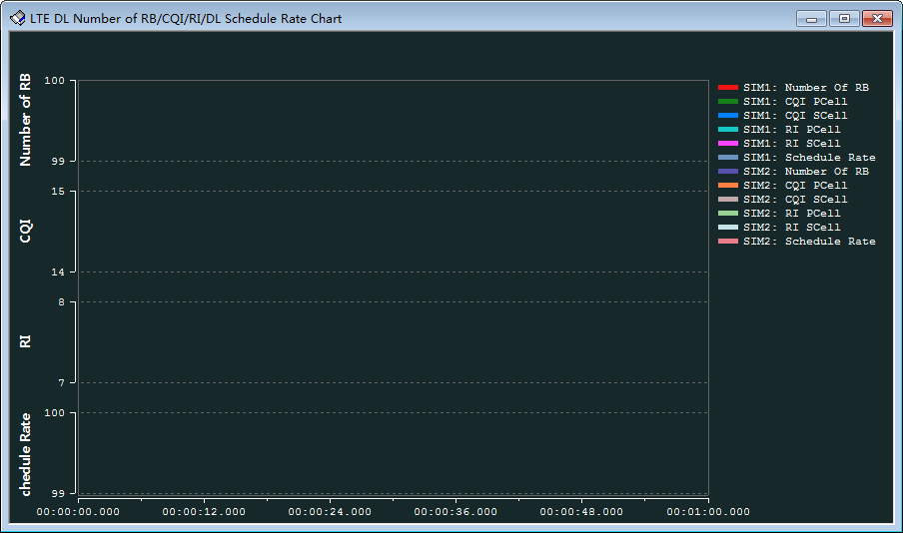
[View] LTE DL Number of RB/CQI/RI/DL Schedule Rate Chart
Open the view by the menu
View -> LTE -> LTE DL Number of RB/CQI/RI/DL Schedule Rate Chart
Function
Draw blow lines
Number of RB
CQI/
RI/
Schedule Rate

Slide 33
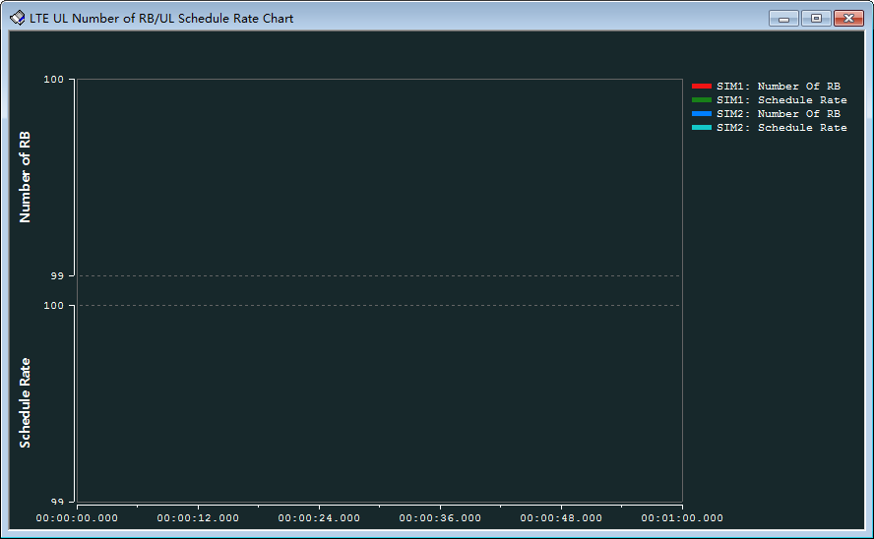
[View] LTE UL Number of RB/UL Schedule Rate Chart
Open the view by the menu
View -> LTE -> LTE UL Number of RB/UL Schedule Rate Chart
Function
Draw blow lines
Number of RB
Schedule Rate

Slide 34
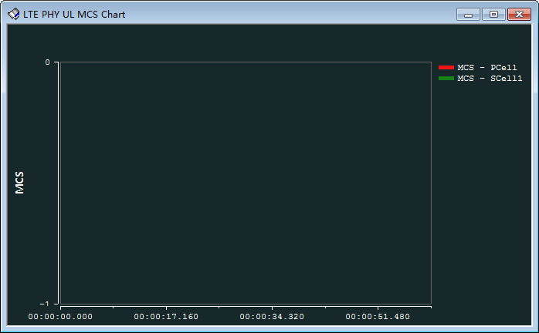
[View] LTE PHY UL MCS Chart
Open the view by the menu
View -> LTE -> LTE PHY UL MCS Chart
Function
Draw blow lines
MCS

Slide 35
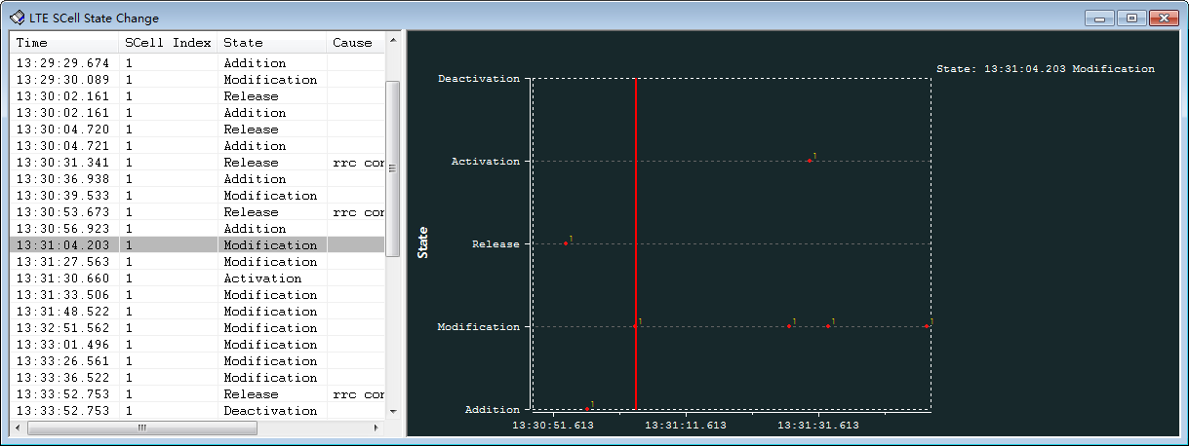
[View] LTE SCell State Change
Open the view by the menu
View -> LTE -> LTE SCell State Change
Function
Draw bellow point
State

Slide 36
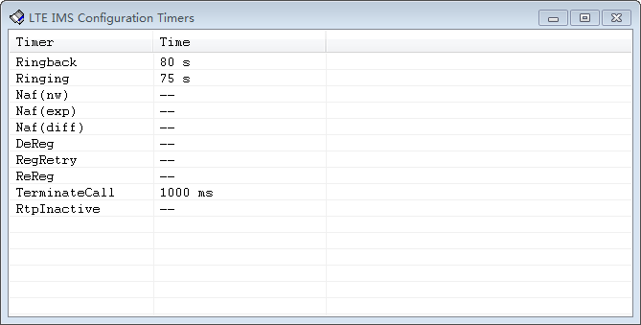
[View] LTE IMS Configuration Timers
Open the view by the menu
View -> LTE -> LTE IMS Configuration Timers
Function
Show list column value bellow
Timer
Time

Slide 37
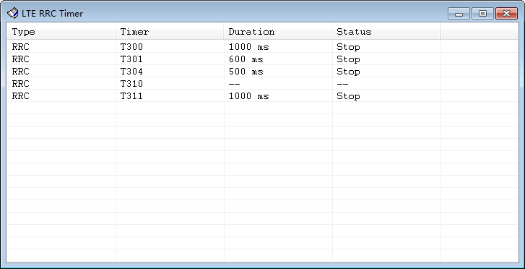
[View] LTE RRC Timer
Open the view by the menu
View -> LTE -> LTE RRC Timer
Function
Show list column value bellow
Type
Timer
Duration
Status

Slide 38
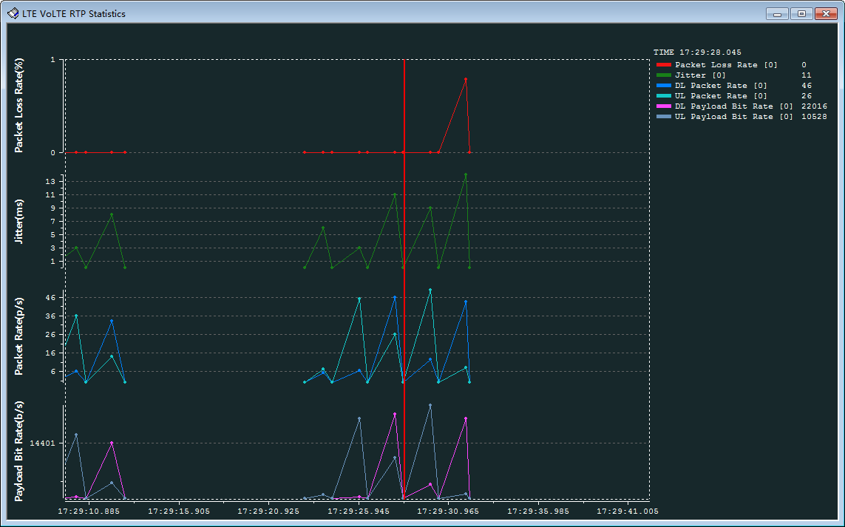
[View] LTE VoLTE RTP Statistics
Open the view by the menu
View -> LTE -> LTE VoLTE RTP Statistics
Function
Draw bellow lines
Payload Bit Rate
Packet Rate
Jitter
Packet Loss Rate

Slide 39
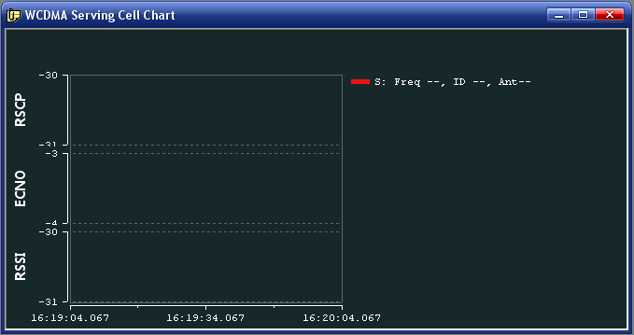
[View] WCDMA Serving Cell Chart
Open the view by the menu
View -> WCDMA -> WCDMA Serving Cell Chart
Function
Draw blow lines
RSCP Ant0
RSCP Ant1
ECNO Ant0
ECNO Ant1
RSSI Ant0
RSSI Ant1

Slide 40
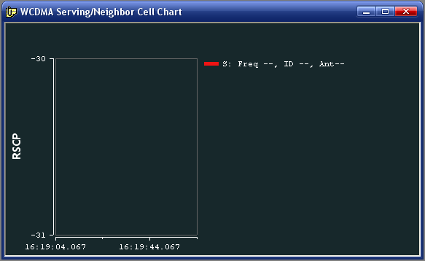
[View] WCDMA Serving/Neighbor Cell Chart
Open the view by the menu
View -> WCDMA -> WCDMA Serving Cell Chart
Function
Draw blow lines
RSCP Ant0
RSCP Ant1

Slide 41
[View] WCDMA Serving/Neighbor Cell Chart
Open the view by the menu
View -> WCDMA -> WCDMA Serving Cell Chart
Function
Draw blow lines
RSCP Ant0
RSCP Ant1

Slide 42
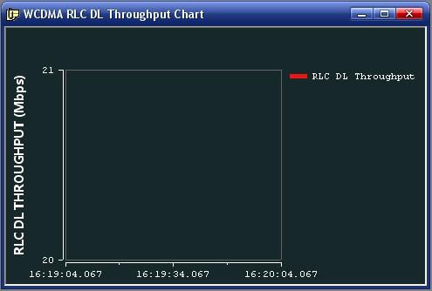
[View] WCDMA RLC DL Throughput Chart
Open the view by the menu
View -> WCDMA -> WCDMA RLC DL Throughput Chart
Function
Draw blow lines
RLC DL Throughput

Slide 43

[View] WCDMA RLC UL Throughput Chart
Open the view by the menu
View -> WCDMA -> WCDMA RLC UL Throughput Chart
Function
Draw blow lines
RLC UL Throughput

Slide 44
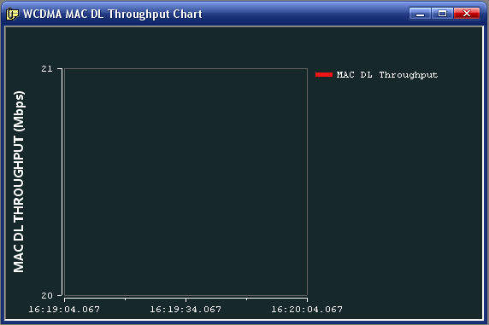
[View] WCDMA MAC DL Throughput Chart
Open the view by the menu
View -> WCDMA -> WCDMA MAC DL Throughput Chart
Function
Draw blow lines
MAC DL Throughput

Slide 45
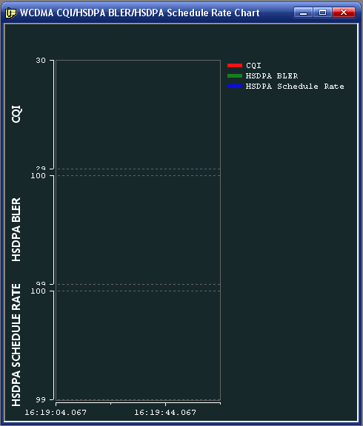
[View] WCDMA CQI/HSDPA BLER/HSDPA Schedule Rate Chart
Open the view by the menu
View -> WCDMA -> WCDMA CQI/HSDPA BLER/HSDPA Schedule Rate Chart
Function
Draw blow lines
CQI
HSDPA BLER
HSDPA Schedule Rate

Slide 46
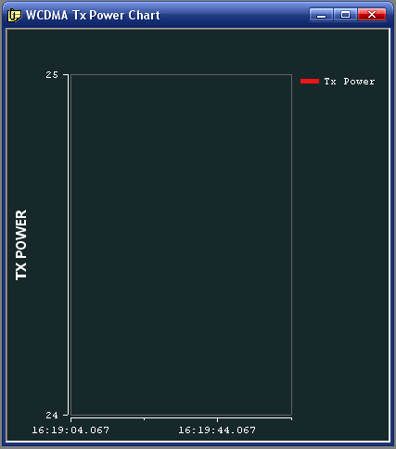
[View] WCDMA Tx Power Chart
Open the view by the menu
View -> WCDMA -> WCDMA Tx Power Chart
Function
Draw blow lines
Tx Power

Slide 47
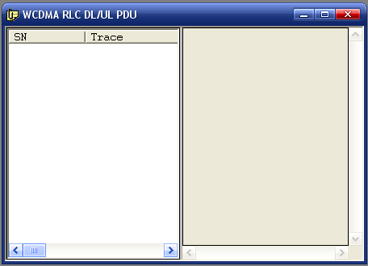
[View] WCDMA RLC DL/UL PDU
Open the view by the menu
View->WCDMA> WCDMA RCL DL/UL PDU
Function
Left view is the same as All Traces window and
shows the filtered trace items
Double click this item to parser the RCL PDU data
and show them in the right window

Slide 48
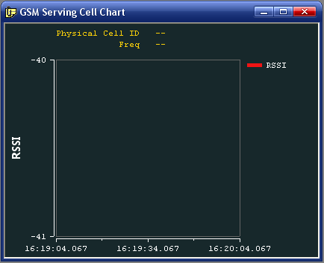
[View] GSM Serving Cell Chart
Open the view by the menu
View -> GSM-> GSM Serving Cell Chart
Function
Draw blow lines
RSSI

Slide 49
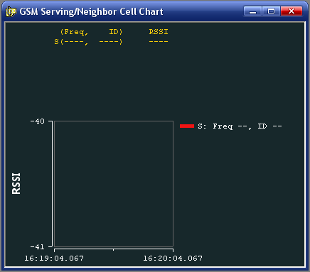
[View] GSM Serving/Neighbor Cell Chart
Open the view by the menu
View -> GSM-> GSM Serving/Neighbor Cell Chart
Function
Draw blow lines
RSSI

Slide 50
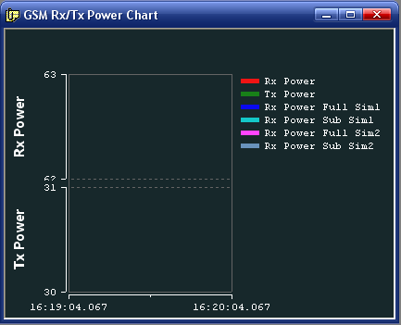
[View] GSM Rx/Tx Power Chart
Open the view by the menu
View -> GSM-> GSM Rx/Tx Power Chart
Function
Draw blow lines
Rx Power
Tx Power
Rx Power Full Sim1
Tx Power Sub Sim1
Rx Power Full Sim2
Tx Power Sub Sim2

Slide 51
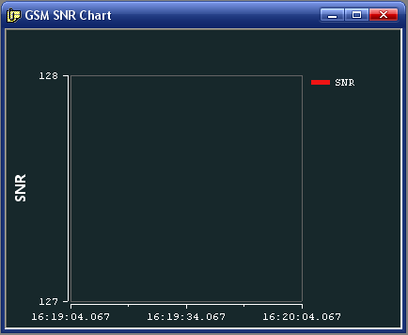
[View] GSM SNR Chart
Open the view by the menu
View -> GSM-> GSM SNR Chart
Function
Draw blow lines
SNR

Slide 52
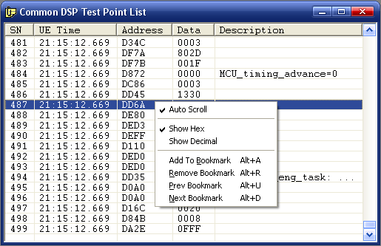
[View] [DSP Test Point] Common DSP Test Point List
Open the view by the menu
View -> DSP Test Point-> Common DSP Test Point List
Popup Menu
Auto Scroll
Show Hex (only for data column)
Show Decimal(only for data column)
Add to Bookmark (Alt+A)
Remove Bookmark (Alt+R)
Pre Bookmark (Alt+U)
Next Bookmark (Alt+D)
Sync to other views
Double click the item to sync
Search
Step search in the toolbar to input search string
Ctrl+G to locate the item by SN

Slide 53
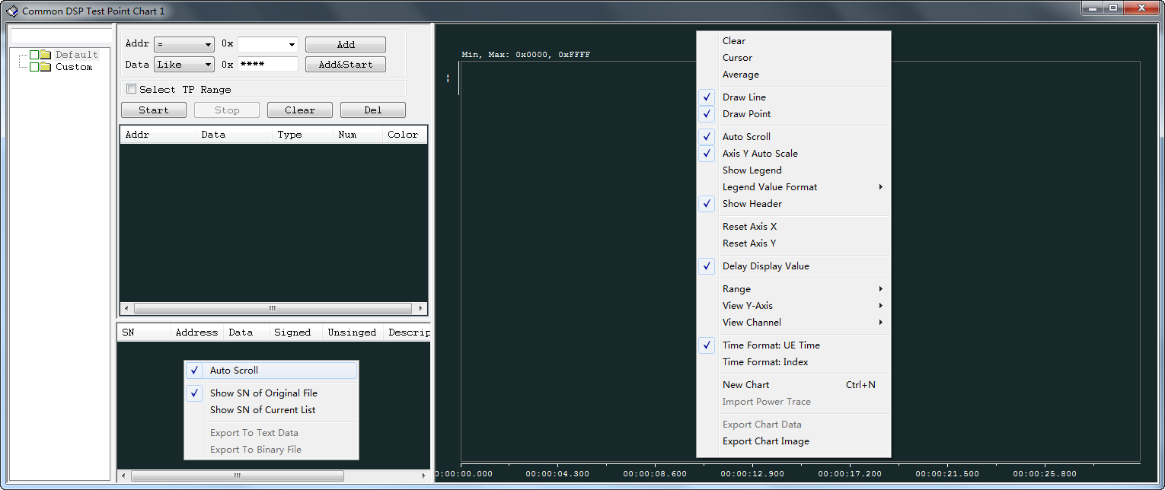
[View] [DSP Test Point] Common DSP Test Point Chart
Open the view by the menu
View -> DSP Test Point-> Common DSP Test Point Chart
Functions
Control Panel: Set Address and Data filter condition. You add more conditions by Add button. To start/stop filter and drawing by Start/Stop button;
Filter Data View: List the data filtered by conditions in the control panel
Chart View: Draw the data

Slide 54
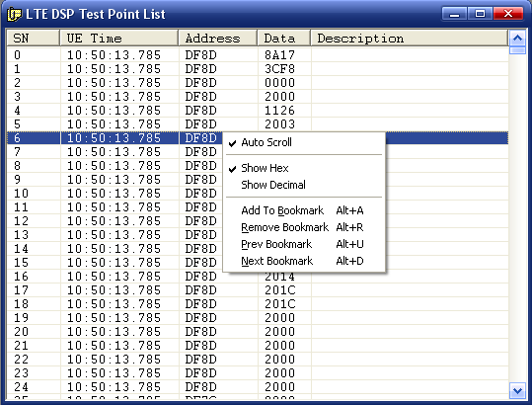
[View] [DSP Test Point] LTE DSP Test Point List
Open the view by the menu
View -> DSP Test Point-> LTE DSP Test Point List
Popup Menu
Auto Scroll
Show Hex (only for data column)
Show Decimal(only for data column)
Add to Bookmark (Alt+A)
Remove Bookmark (Alt+R)
Pre Bookmark (Alt+U)
Next Bookmark (Alt+D)
Sync to other views
Double click the item to sync
Search
Step search in the toolbar to input search string
Ctrl+G to locate the item by SN

Slide 55
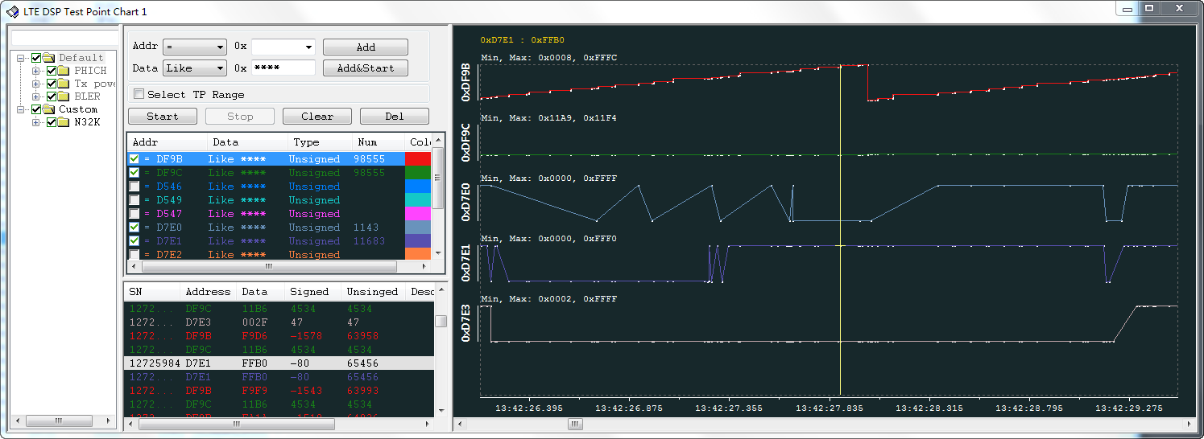
[View] [DSP Test Point] LTE DSP Test Point Chart
Open the view by the menu
View -> DSP Test Point-> LTE DSP Test Point Chart
Functions
Control Panel: Set Address and Data filter condition. You add more conditions by Add button. To start/stop filter and drawing by Start/Stop button;
Filter Data View: List the data filtered by conditions in the control panel
Chart View: Draw the data

Slide 56
[View] [DSP Test Point] TG DSP Test Point List
Open the view by the menu
View -> DSP Test Point-> TG DSP Test Point List
Popup Menu
Auto Scroll
Show Hex (only for data column)
Show Decimal(only for data column)
Add to Bookmark (Alt+A)
Remove Bookmark (Alt+R)
Pre Bookmark (Alt+U)
Next Bookmark (Alt+D)
Sync to other views
Double click the item to sync
Search
Step search in the toolbar to input search string
Ctrl+G to locate the item by SN
View is same as LTE DSP Test Point List

Slide 57
[View] [DSP Test Point] TG DSP Test Point Chart
Open the view by the menu
View -> DSP Test Point-> TG DSP Test Point Chart
Functions
Control Panel: Set Address and Data filter condition. You add more conditions by Add button. To start/stop filter and drawing by Start/Stop button;
Filter Data View: List the data filtered by conditions in the control panel
Chart View: Draw the data
View is same as LTE DSP Test Point List

Slide 58
[View] [DSP Test Point] AG DSP Test Point List
Open the view by the menu
View -> DSP Test Point-> AG DSP Test Point List
Popup Menu
Auto Scroll
Show Hex (only for data column)
Show Decimal(only for data column)
Add to Bookmark (Alt+A)
Remove Bookmark (Alt+R)
Pre Bookmark (Alt+U)
Next Bookmark (Alt+D)
Sync to other views
Double click the item to sync
Search
Step search in the toolbar to input search string
Ctrl+G to locate the item by SN
View is same as LTE DSP Test Point List

Slide 59
[View] [DSP Test Point] AG DSP Test Point Chart
Open the view by the menu
View -> DSP Test Point-> AG DSP Test Point Chart
Functions
Control Panel: Set Address and Data filter condition. You add more conditions by Add button. To start/stop filter and drawing by Start/Stop button;
Filter Data View: List the data filtered by conditions in the control panel
Chart View: Draw the data
View is same as LTE DSP Test Point List

Slide 60
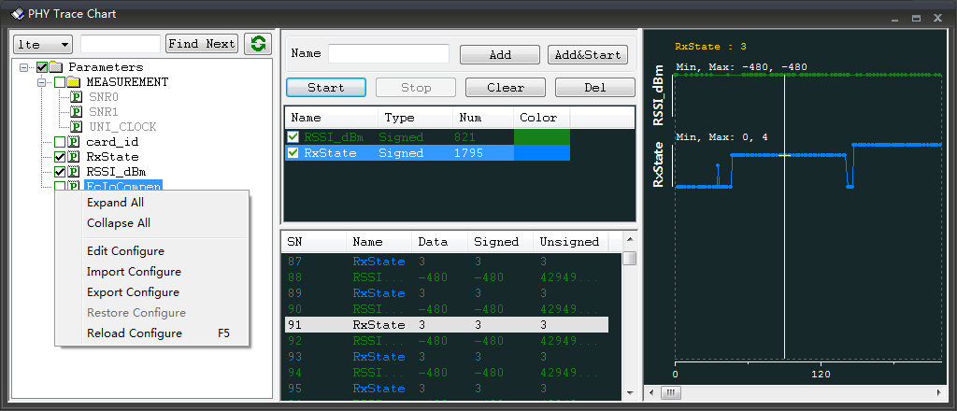
[View] PHY Trace Chart
Open the view by the menu
View -> Common -> PHY Trace Chart
Functions
Left View ：Show all parameters for draw， select some of them to draw chart.
If cannot find trace id for parameter format string in parser, the parameter show grey
Middle Up View : Function buttons: input part of parameter name to quick select parameter to draw chart.
Double click type cell to change data type to sign or unsigned.
Middle Bottom View: Show the data filtered from the PHY trace
Notice
1. Configure "PHYChartTraceFmt.xml"
a)Click Edit Configure in the menu of left view
editing as notice in this file
b)Click Reload Configure or F5 to refresh
2. Only support trace id formatted trace output
from device, not support raw string output.
3. Not support real-time drawing.
Start button enabled until log loading finished

Slide 61
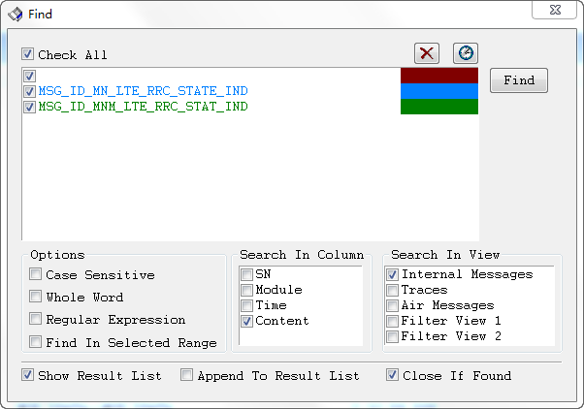
Search(1) : Ctrl+F
Ctr+F to open Find window in Internal Messages / Traces / Air Messages / Filter View 1 ~ 6)
Top List box is used to input search key words,
Record search history, Delete key words
Ctrl+A to select all key words, Ctrl+Z to un-select all key words
Click “Check All”to check or un-check all key words
Set key words color to double click the color rect.
Select history search keywords to click button
Options:
Case Sensitive
Whole Word
Regular Expression
Find In Selected Items
Search In Column
SN, Module, Time, Content
Search In View
Internal Messages, Traces, Air Messages, Filter View 1 ~ 6
Show Result List
Append To Result List
Close If Found
Close this dialog if found.
Notes:
Requirement ID: RS-ANA-0013

Slide 62

Search(2): One Step Search
Input the find string in the toolbar edit box and end with Enter key to start search
Press F3 to find next
Press Shift + F3 to find previous
Only All Messages View/All Traces View/All MSG Flow View/ *DSP Test Point List support this function.

Slide 63
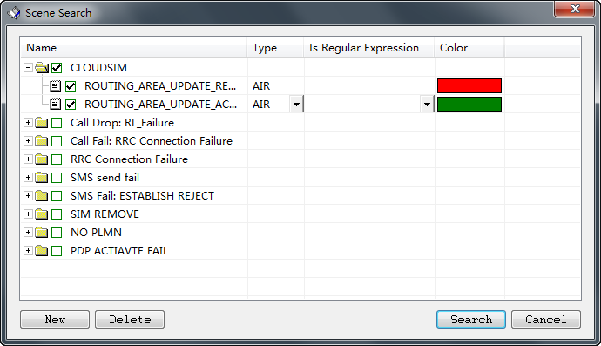
Search(3): Scene Search
Open Scene search for messages
Menu: Edit->Scene Search
You can add or delete message/air by click new or delete button.
Introduction
There are many scenes defined in this window
You can quick to find the key messages

Slide 64
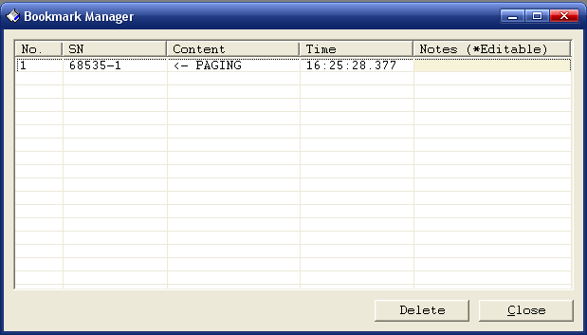
Bookmark
Message/Trace/Msg Flow items can be bookmarked
Add items to bookmark or locate them by popup menu in these views (All Messages/All Trace/All Msg Flow)
Hot keys:
Alt+A: add item to bookmark
Alt+R: remove one bookmark
Alt+U: go to previous bookmark
Alt+D: go to next bookmark
Toolbar button: support above four operations
Bookmark Manager
Open Bookmark Manager By Menu
Edit -> Bookmark Manager
Add notes for bookmark items
Double click item to locate it

Slide 65
Window Management
Layout Views
Menu: Windows->Cascade
Menu: Windows->Tile Horizon
Menu: Windows->Tile Vertical
Menu: Windows->Tile Vertical
Menu: Windows->Minimize All
Menu: Windows->Restore All
Menu: Windows->Close ALL
Menu: Windows->Arrange Icons
Remember Views Layout
Logel Tool can remember the views' layout
Notes:
Requirement ID: RS-GUI-0003
Requirement ID: RS-GUI-0004

Slide 66

[Filter] Capture Filter
Open menu: Option->Device Configure
This will control the log output from device
PS LOG
DSP LOG
AUDIO
Functions
Show AT Command: Display the AT command
Import: Import a customer configure
Export: Save the configure to a xml file
Restore: Restore to default configure
Configure: Send control command to device
Notes:
Requirement ID: RS-CAP-0001

Slide 67

[Filter] View Filter
Select popup menu “Filter”in All Messages/All Traces view
This will filter what the user want to filter and show them in a new view
Notes:
Requirement ID: RS-ANA-0008

Slide 68
Tools
Menu Tool
Menu Item | Comment
Assert | Show Assert Frame, trigger device to assert
System Info | Run script to communicate with device
iLog | Get log by Bug ID and replay it
Device Control | Send some command to device
Log Data Statistics | Statistics about log size and lost rate
Check Dump File Integrity | Check dump file integrity for CP and AP
CP Dump File Transfer | Extract log data from dump, ring buffer file.
Capture W/TD/GSP IQ Log | Capture IQ Log and save them to file
Export Log From UE | Call AndroidLog2PC script to capture YLOG from device
Export Titan Files | Export Titan files for WCAMA
Export Call Setup Statistics | Output call setup statistics into csv file
Export Log Statistics By Module | Output log size statistics by module into csv file
Export Tcl Script Files | Output TCL script files for some message data
Export Network Parameters | Output network parameters into csv file
Export Network Capabilities | Output network capabilities into csv file
Show GPS Map | Show GPS map

Slide 69

Tools-Unpack Mini Memory File
Tools->CP Dump File Transfer->Unpack Mini Memory File
Memory File: Select the mini dump file
Output Dir: Select a directory to save the unpacked files

Slide 70

Tools-Extract Log From System Memory File
Tools->CP Dump File Transfer->Extract Log From System Memory File
Memory File: Select the system dump file
MAP File: Select the map file matched with the modem version
AFX File: Select the afx file matched with the modem version
Logel File: Select a save path to store the .logel file extracted.

Slide 71

Tools-Extract Log From Mini Memory File
Tools->CP Dump File Transfer->Extract Log From System Memory File
Memory File: Select the mini memory file unpacked from mini dump file
Logel File: Select a save path to store the .logel file extracted.

Slide 72



Tools- Show GPS Map
Tools->Show GPS Map, select GPS (GNSS) log file
You can switch GPS map provider here, and click “OK” to save settings. Default provider is Google.
Locate both side data by double click

Slide 73

[Toolbar] Log data monitor
There are three circle icon to display different kinds of data output state
1st button: PS data
2nd button: PHY data (DSP data)
3rd button: AGDSP data
State:
Initial state, not connect or not replay log
Ready state, no data coming, this kind of data size is zero
Data coming state, new data is coming
No new data coming more than 5 seconds
Show more detail information:
Click any button of these three buttons to show detail in tip, and then click any
position to hide this tip.
Notes:
Requirement ID: RS-GUI-0001

Slide 74

[Status bar]
There are 5 column in status bar
System state and tip
Tool state and tip
Log lost statistics
Assert
Modem version
Click here to show “Log Lost Statistics”
Notes:
Requirement ID: RS-GUI-0001

Slide 75
[CMD Parameters]
Support command line start Armlogel.exe
Cmd line parameters format:
None blocking mode: Armlogel.exe –f <filepath> [options]
Blocking mode: start /WAIT Armlogel.exe –f <filepath> [options]
Format description:
Parameters | Description
-f <filepath> | Set .logel/.log/.lst file full path.
-d <ParserLibDir> | Set parser library directory.
-r [Start, [End|+Offset]] | Set sequence number range. e.g. -r 10021,30059 -r 10021,+500 // +500 is an offset from 10021-1
Notes:
Requirement ID: RS-GUI-0001

Slide 76
[CMD Parameters]
-t [tmpdir] | Set the folder to store temporary files when playing back.
-n [WndClassName] | Set the WndClassName so that 3rd program could obtain Armlogel window handle, and send messages to it. Remarks: If 3rd program open the same Armlogel.exe, the –n option must be unique.
-p [Position] | Set the position to locate the related log data when finish playing back. If the position given overflow the SN range in –r option, nothing will be happened.
-w [min|max|hide] | Set the window’s show style. min: minimize max: maximize hide: hide
-q | Auto quit exe when finish playing back.
-m [yes|no] | Whether to show error message box or not during playback if error occurs, default not to show.
Notes:
Requirement ID: RS-GUI-0001

Slide 77
[CMD Parameters]
-l [logStatisticDir] | Export log size statistics by module after log loading finished. logStatisticDir - output file’s directory Notice: If “logStatisticDir” not specified, result file will be output to the same directory as the loaded log file.
-o [m|t|f|s|w] | Indicate that export Msg/Trace/Air/DSP TP detail to txt file. It usually carries three parameters such as: -o mtf. The parameters can be freely combined. m: Msg; t: Trace; f: Air; d:DSP Test Point there are another two option: s: only export message name and .etc content but no detail message tree for Msg/Air. w: use wireshark to decode air message if export air detail message e.g. export air detailmessage using wireshark to parse -o fw e.g. only export msg no detail -o ms e.g. export DSP Test Point -o “d|lte:0xDF9B,0xDF9c|tg” Notice: If you don’t want to filter any air(or msg) message just use: -o fw or -o f If you want to filter some message notice that use "" : –o "f|air:UECAPABILITYINFORMATION,RRCCONNECTIONRECONFIGURATION“ –o “m|msg:MSG_ID_BCCH_BCH_MSG_TYPE, MSG_ID_IMS_SIP_DOWN_MSG“
Notes:
Requirement ID: RS-GUI-0001

Slide 78

THANK YOU!

